Slide 1
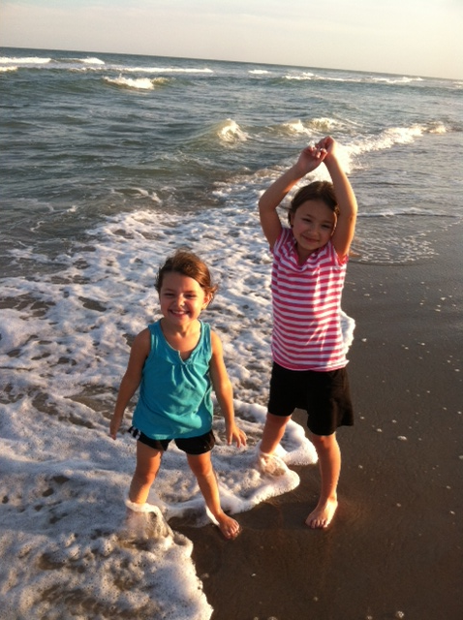
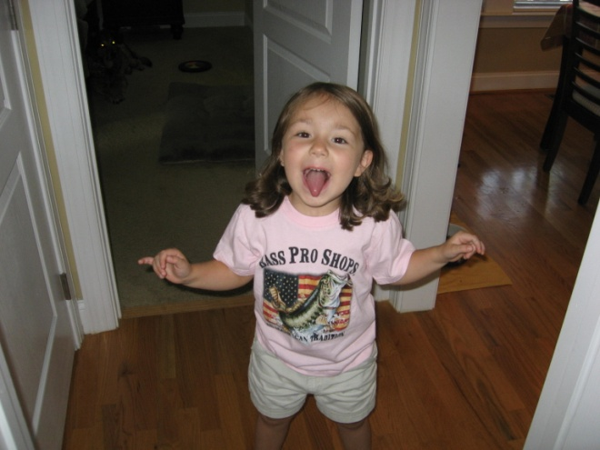
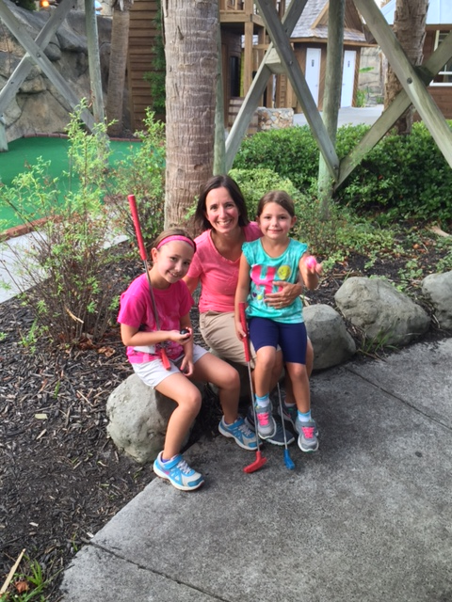
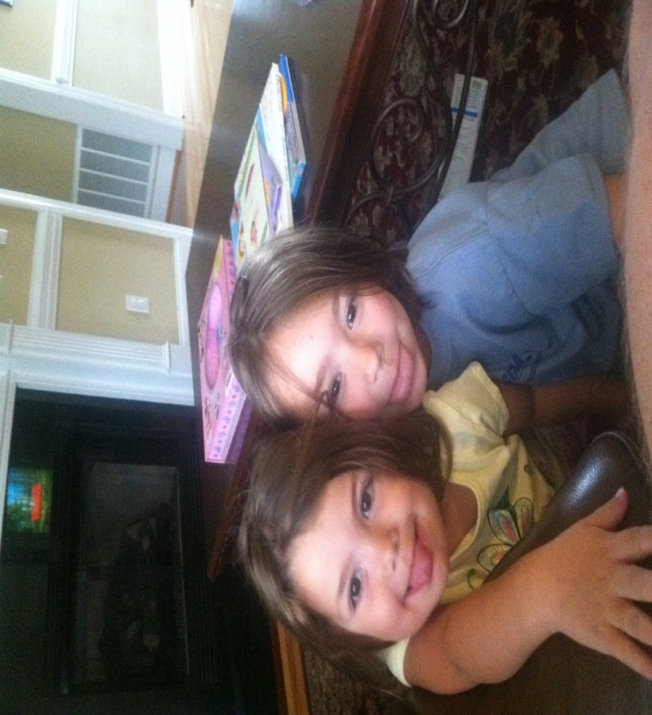
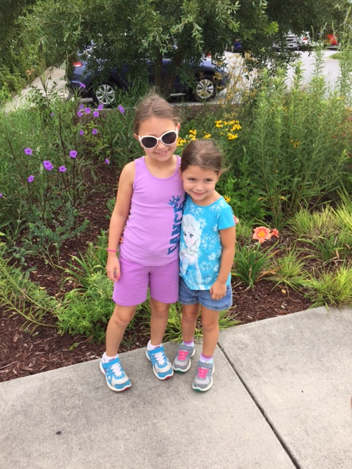
Married with two wonderful daughters. Olivia and Julia

Slide 2
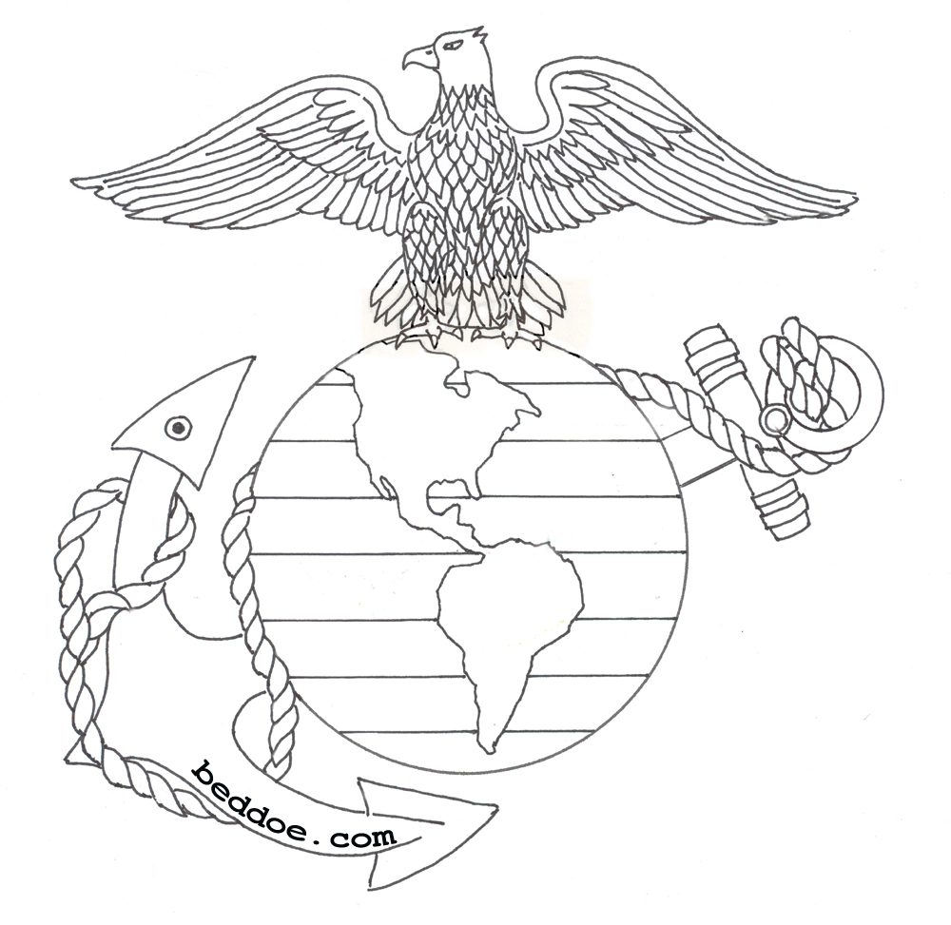
Born and raised in Northern New Jersey. About 5 miles from New York City.
Went into the Marine Corps a year after high school. I served 8 years.
Served overseas on every continent except Antarctica and S. America.

Slide 3
Before I started teaching I worked for the State Department of Education.
Graduated from NCCU in Durham.
Go Eagles!
Certified to teach Science 6-9 and Social Studies 6-9.

Slide 4
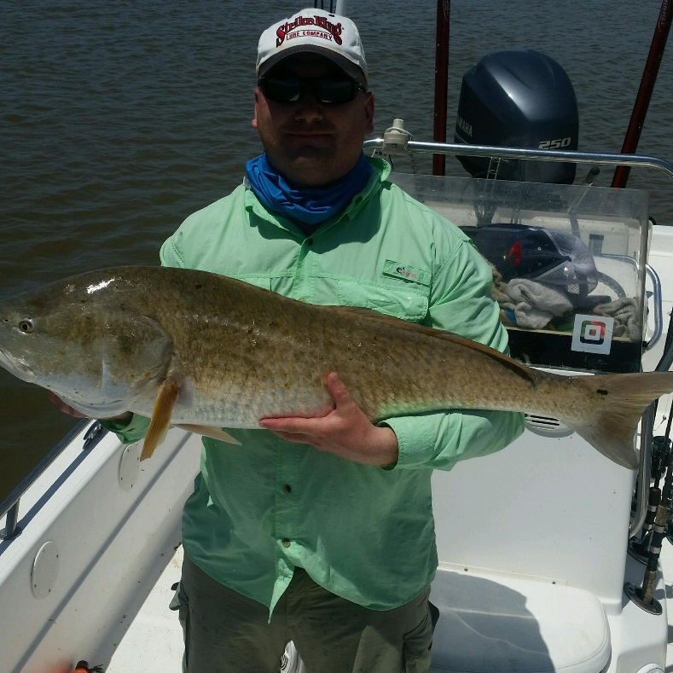
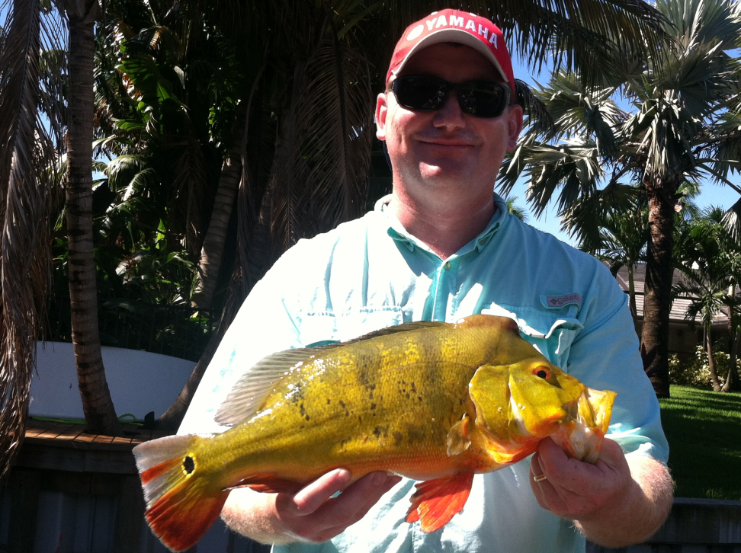
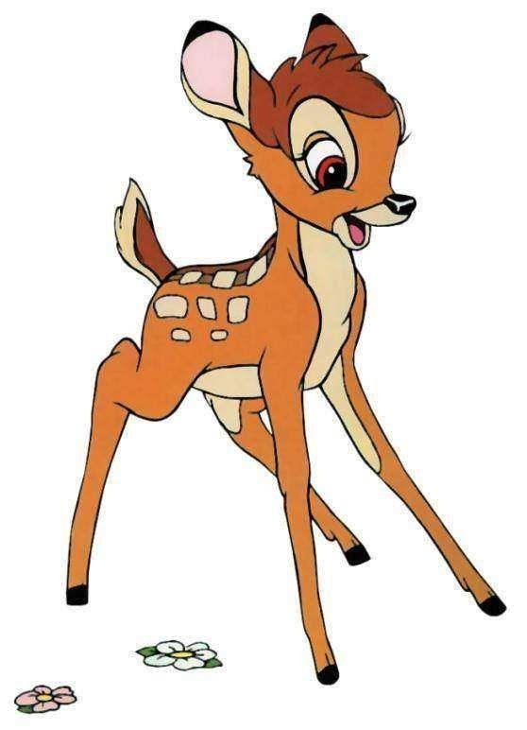
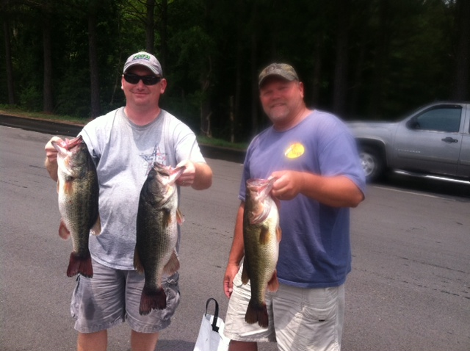
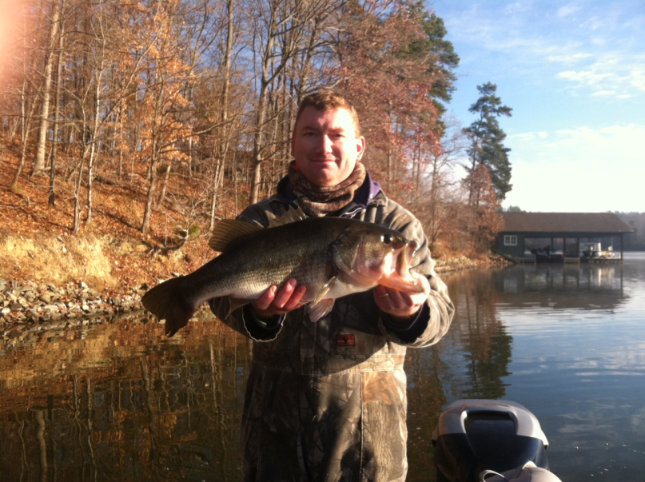
I love the outdoors.
I fish-bass tournaments and hunt…

Slide 5
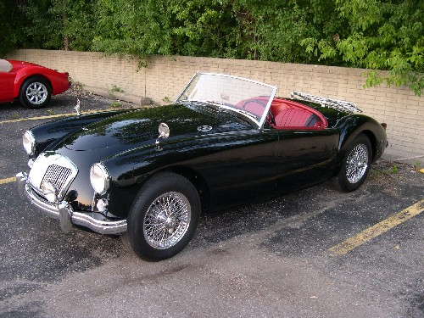
Enjoy working on cars. My 1958 MGA.

Slide 6
Questions?

